Slide 1
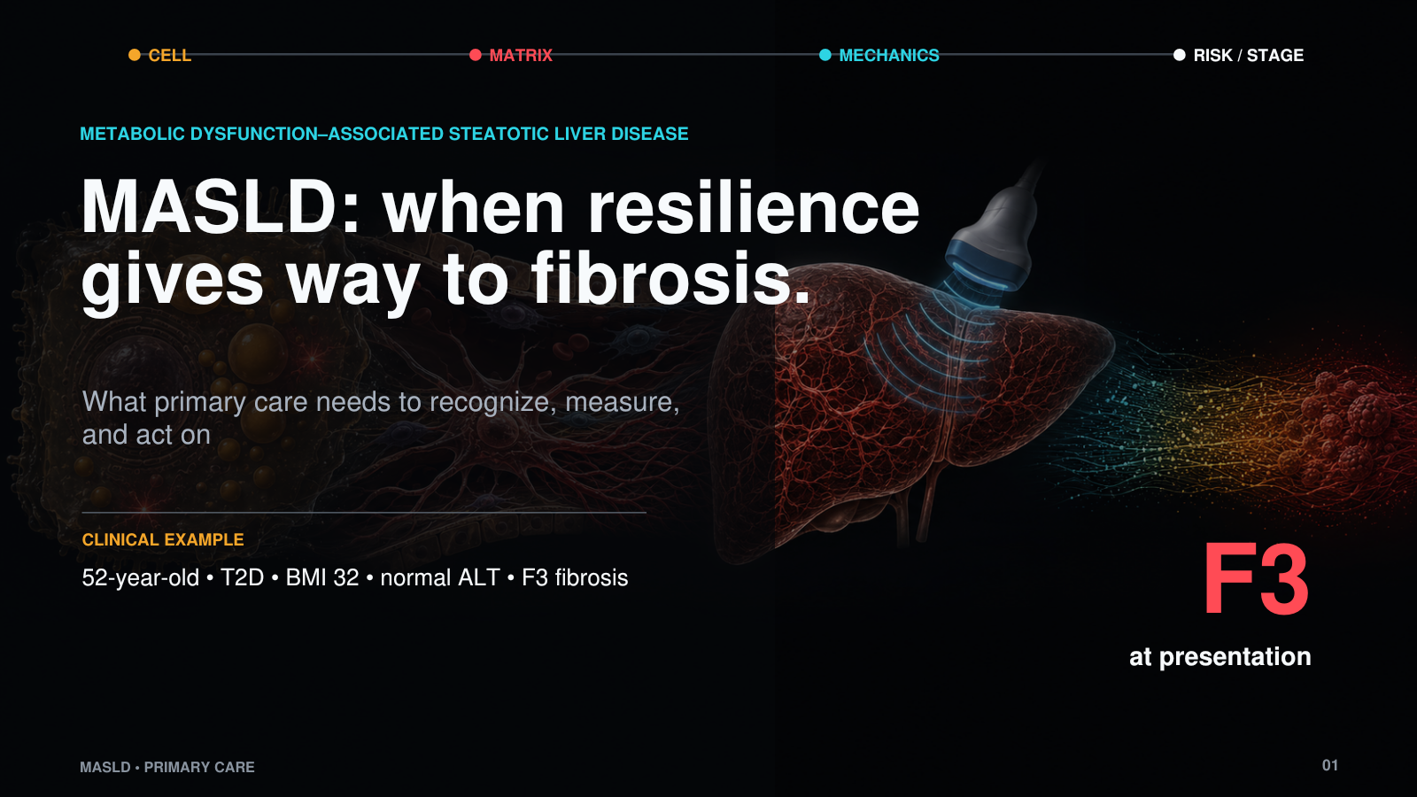
Notes:
MASLD, or what we used to call fatty liver disease, is already one of the most common forms of chronic liver disease and is becoming an increasingly important cause of cirrhosis and liver failure. I think the easiest way to understand it is as a story of hepatic resilience. The liver is asked to handle excess fat for years, and for a long time it can. The disease becomes clinically important when that ability to compensate begins to fail and the repair response becomes fibrosis. That is the path I want to follow: from metabolic stress, to what happens inside the hepatocyte, to fibrosis in the space of Disse, and finally to the stiffness measurement that lets us detect it without a biopsy.
Source: Rinella ME et al. AASLD Practice Guidance. Hepatology. 2023;77:1797-1835.

Slide 2
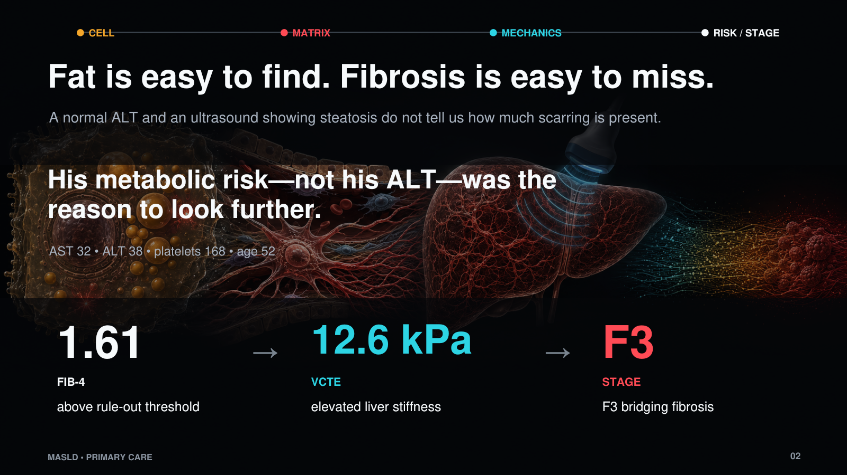
Notes:
This is the kind of patient who is easy to underestimate. He has type 2 diabetes, a BMI of 32, and an ALT that is not alarming. The ultrasound tells us that fat is present, but it does not tell us whether the liver has remained resilient or whether fibrosis is already developing. His FIB-4 is 1.61, so advanced fibrosis cannot be ruled out. VCTE is 12.6 kPa, and further evaluation confirms F3 fibrosis. The reason to look further was the metabolic risk profile—not an abnormal ALT.

Slide 3
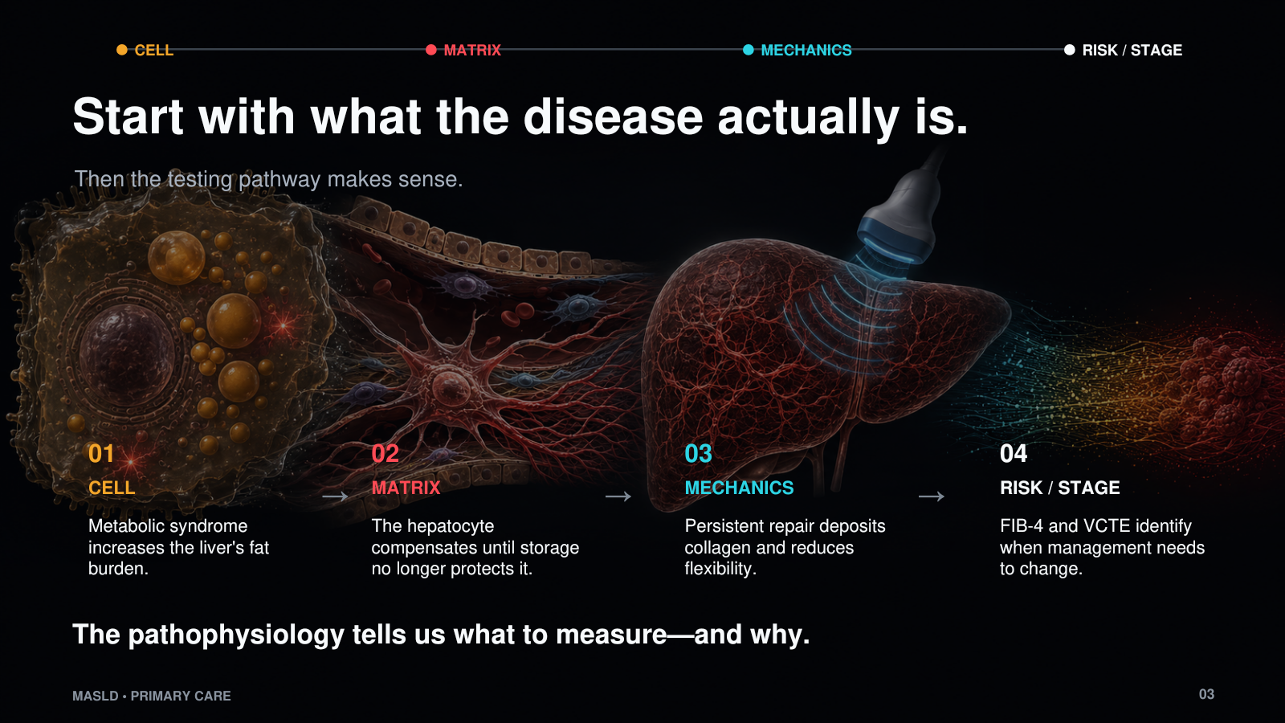
Notes:
The way I want to approach this is to start with what the disease actually is. First, why does a patient with metabolic syndrome accumulate fat in the liver? Second, what can the hepatocyte do with that fat, and where does that compensation begin to fail? Third, how does a normal repair response become collagen deposition in the space of Disse? Once that is clear, the testing pathway is no longer arbitrary. FIB-4 tells us who needs another look, and elastography tells us whether the liver has lost the flexibility we would expect from fibrosis.

Slide 4
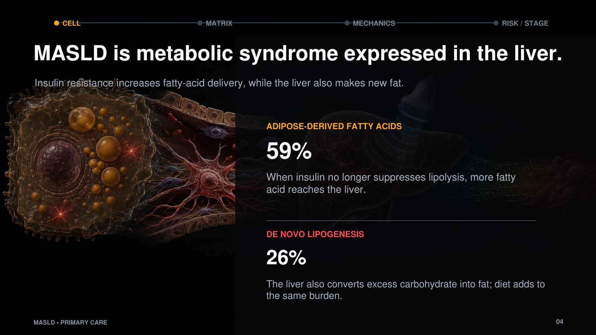
Notes:
Hepatic steatosis is one manifestation of metabolic syndrome. The liver is not acting in isolation. With insulin resistance, adipose tissue continues to release fatty acids into the circulation, and those fatty acids arrive at the liver. In the classic isotope study, about 59 percent of hepatic triglyceride fatty acids came from circulating nonesterified fatty acids and about 26 percent came from de novo lipogenesis. So the liver is both receiving more fat and making more fat. That is why cardiovascular risk and liver risk travel together: they arise from the same underlying metabolic disease.
Source: Donnelly KL et al. J Clin Invest. 2005;115:1343-1351.

Slide 5
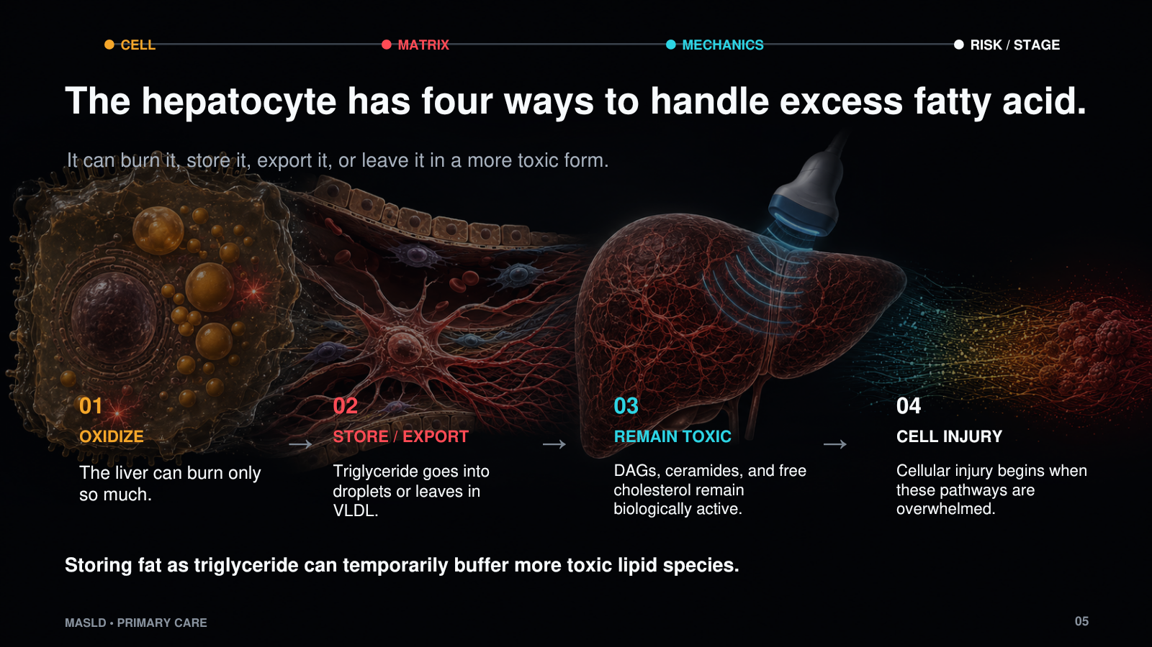
Notes:
Once fat reaches the hepatocyte, there are only a few things the cell can do with it. It can oxidize the fatty acid for energy. It can esterify it and store it as triglyceride. It can package triglyceride into VLDL and export it. Or the lipid can remain in more biologically active forms such as DAGs, ceramides, and free cholesterol. Oxidation and export have limits. Storage is therefore not automatically failure; in some ways, it is part of the liver's resilience. The problem begins when these pathways are overwhelmed and the remaining lipid species begin to injure the cell.

Slide 6
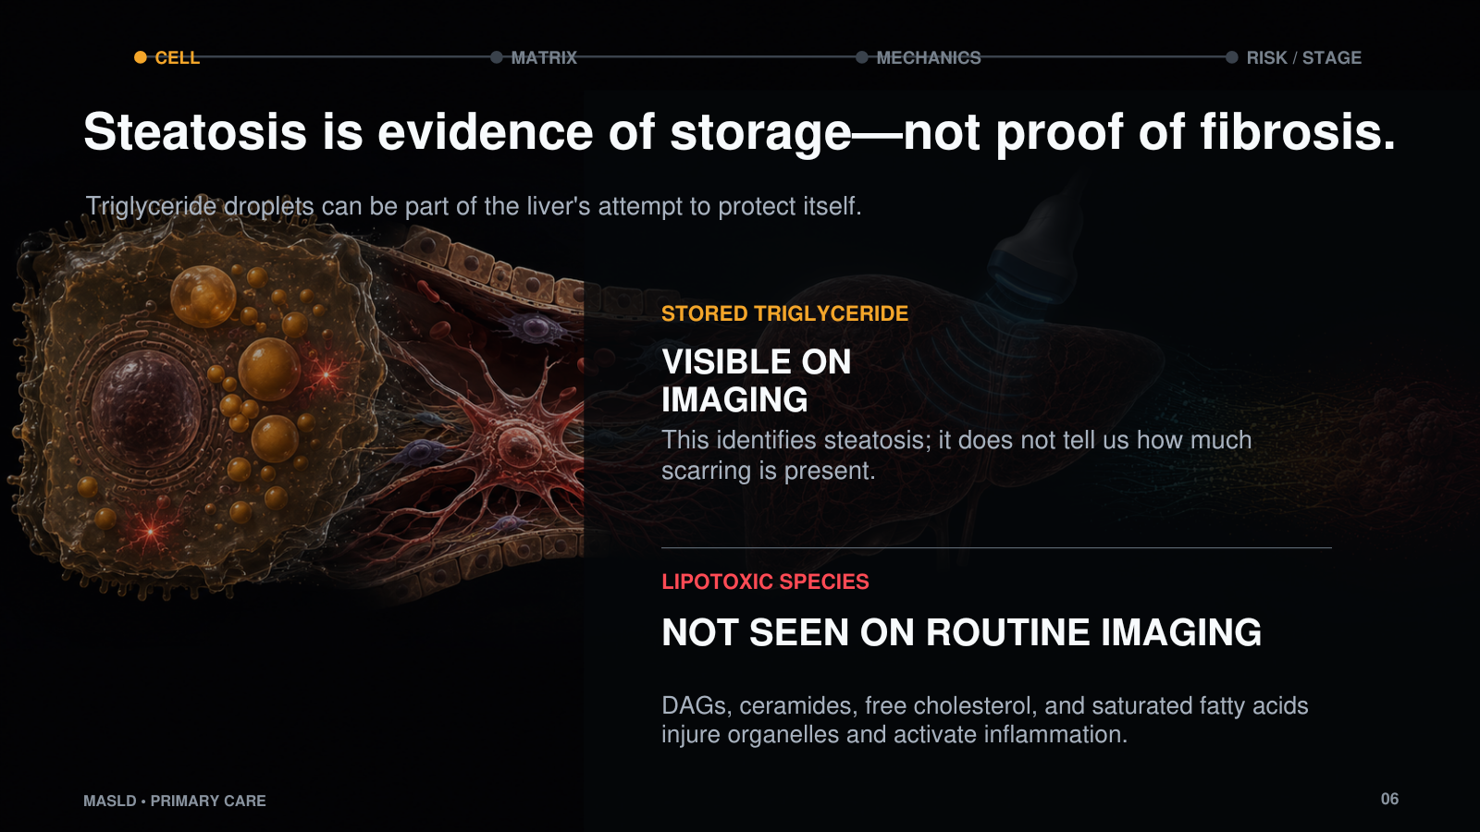
Notes:
This distinction is important because steatosis is what we can see, but it is not necessarily the part causing the injury. A triglyceride droplet tells us the hepatocyte is storing fat. It does not tell us how much lipotoxic stress is occurring and it certainly does not tell us the fibrosis stage. The more toxic lipid species are not visible on routine ultrasound. They disrupt mitochondria and the endoplasmic reticulum, generate oxidative stress, and activate inflammatory signaling. So steatosis is a marker that this metabolic process is present; it is not a direct measurement of the damage we are trying to prevent.
Sources: Listenberger LL et al. PNAS. 2003;100:3077-3082. Yamaguchi K et al. Hepatology. 2007;45:1366-1374.

Slide 7
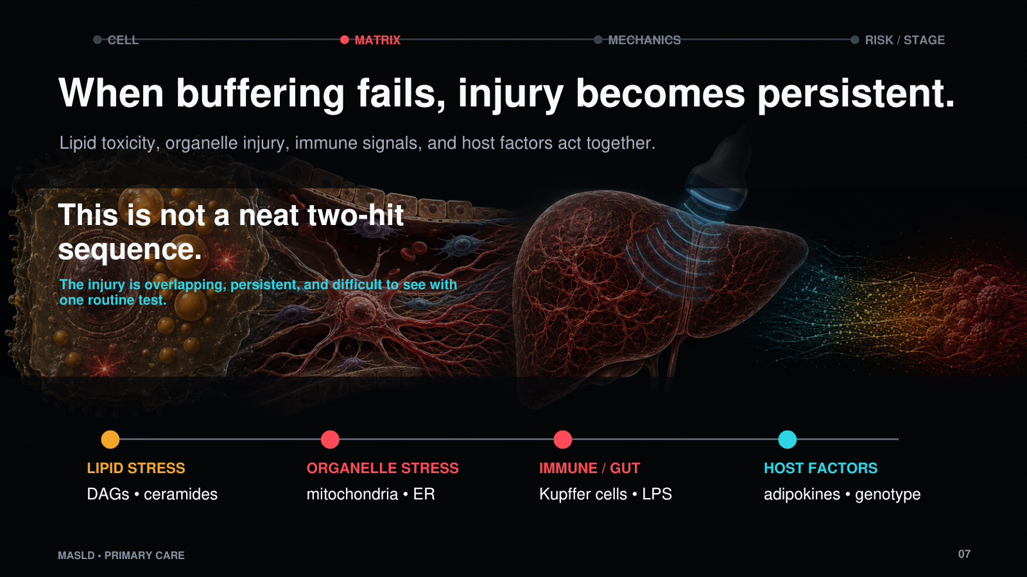
Notes:
The older way of teaching this was as a two-hit process. That is probably too neat. Lipid toxicity, mitochondrial stress, ER stress, Kupffer-cell activation, gut-derived signals, adipokines, and genetic susceptibility are occurring at the same time. What matters clinically is that the hepatocyte is no longer containing the stress. Injury becomes persistent rather than episodic. That is also why no single liver enzyme can tell us the full state of the disease. ALT reflects one part of current hepatocyte injury; it does not summarize the accumulated architectural response.

Slide 8
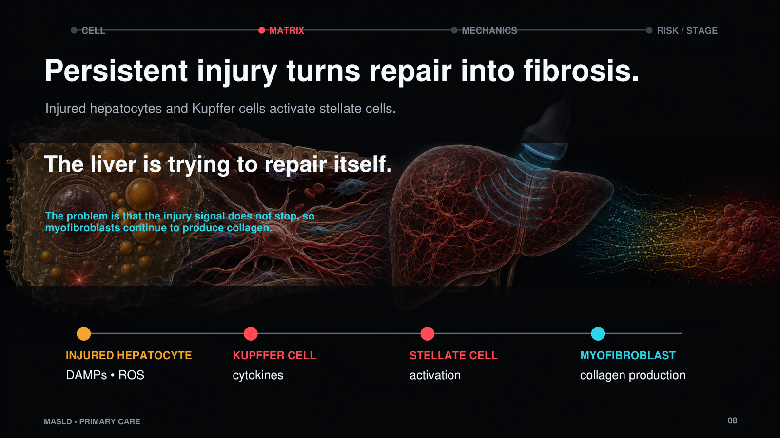
Notes:
The liver responds to injury in the same way it is designed to respond to injury: it tries to repair itself. Injured hepatocytes release DAMPs and oxidative signals. Kupffer cells add inflammatory cytokines. Those signals activate hepatic stellate cells, which transform into collagen-producing myofibroblasts. The problem is not that the repair response exists. The problem is that the injury signal does not stop. A response that should be temporary becomes chronic, and collagen continues to accumulate. That is the transition from metabolic stress to fibrosis.

Slide 9
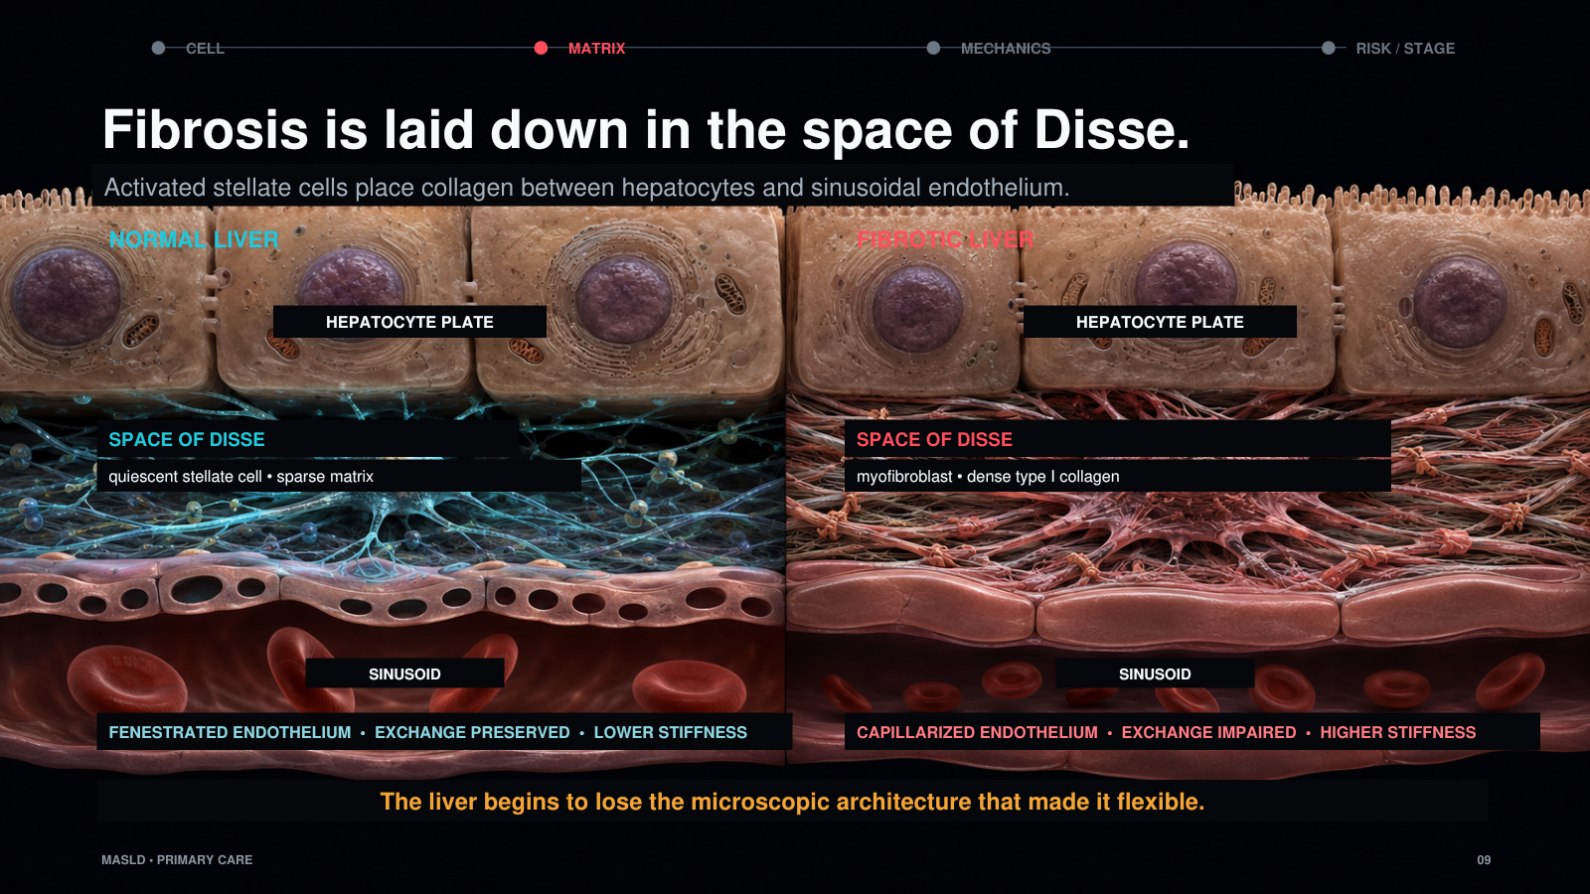
Notes:
This is the space of Disse, and this is where the microscopic process becomes clinically important. Under normal conditions, the space contains a quiescent stellate cell, sparse extracellular matrix, and a fenestrated sinusoidal endothelium that allows exchange with the hepatocyte. With persistent injury, the stellate cell becomes a myofibroblast and deposits type I collagen. The endothelium capillarizes, exchange is impaired, and the architecture thickens. The liver has not simply accumulated fat. It has begun to lose the microscopic organization that made it flexible.

Slide 10
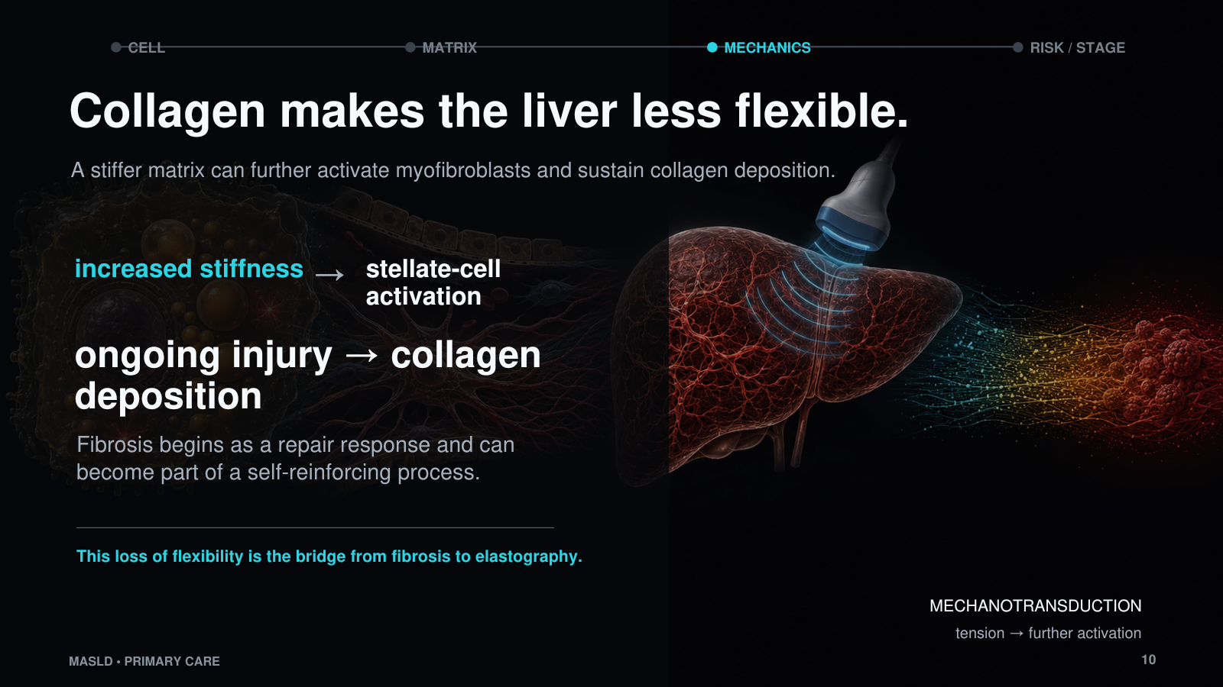
Notes:
As collagen accumulates, the liver becomes less flexible. That stiffness is not only a passive consequence of scar. Stellate cells and myofibroblasts can sense tension in the surrounding matrix through mechanotransduction, and a stiffer matrix can support further activation and collagen production. So fibrosis begins as a response to injury, but it can become part of a self-reinforcing process. This is the bridge to elastography: a microscopic change in the space of Disse eventually becomes a mechanical property that we can measure across the liver.

Slide 11
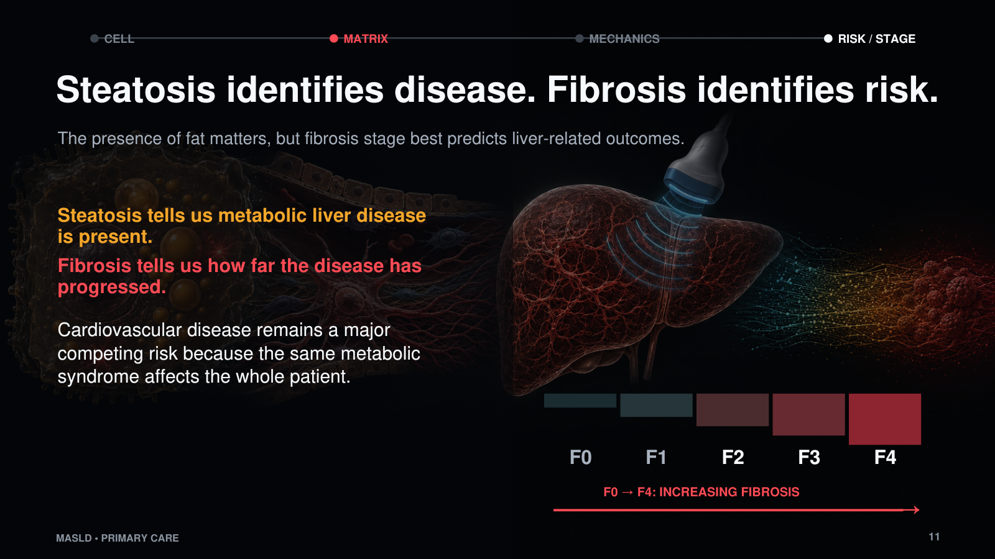
Notes:
This is the distinction I want primary care physicians to leave with. Steatosis identifies the population with metabolic liver disease. Fibrosis identifies the patients at meaningful liver risk. Fat content and inflammation matter, but fibrosis stage is the histologic feature most consistently associated with liver-related outcomes. At the same time, we cannot forget the rest of the patient. Cardiovascular disease remains a major competing cause of morbidity and mortality because MASLD is one expression of systemic metabolic syndrome. Treating the blood pressure, diabetes, lipids, obesity, and smoking risk is part of treating the liver patient.
Sources: Angulo P et al. Gastroenterology. 2015;149:389-397. Dulai PS et al. Hepatology. 2017;65:1557-1565. Ekstedt M et al. Hepatology. 2015;61:1547-1554.

Slide 12
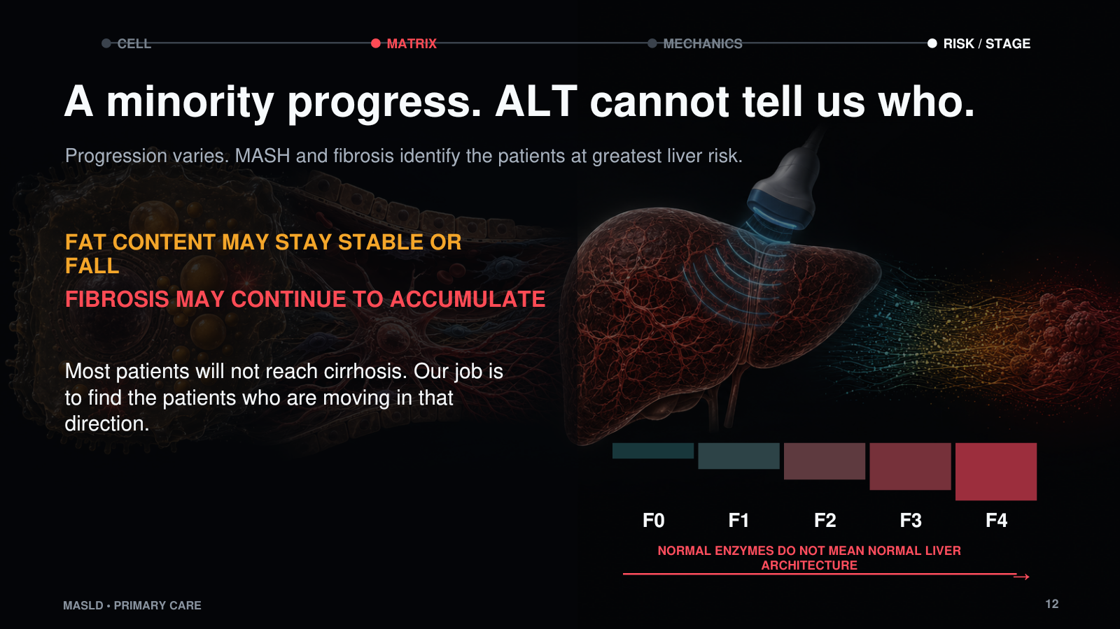
Notes:
Most people with steatosis will not progress to cirrhosis, but the population with steatosis is so large that the minority who do progress represents a major clinical burden. I would not anchor this to one fixed percentage because progression estimates change with the population, duration of follow-up, presence of MASH, diabetes, and baseline fibrosis. The practical point is that we cannot identify the progressive group by ALT alone. Enzymes may remain normal, and liver fat may even fall in advanced disease while fibrosis continues to accumulate. Our job is to identify fibrosis before cirrhosis or decompensation declares itself.
Sources: Rinella ME et al. Hepatology. 2023;77:1797-1835. EASL-EASD-EASO Clinical Practice Guidelines on MASLD. J Hepatol. 2024.

Slide 13
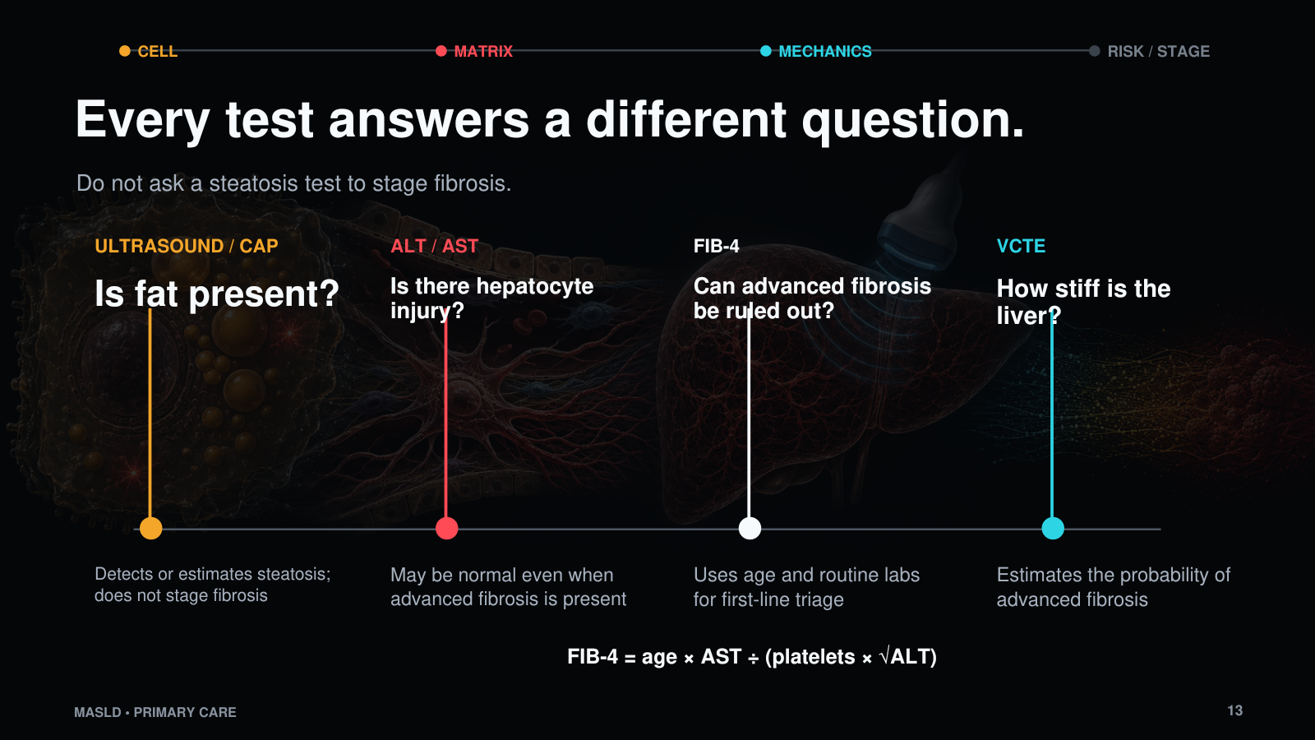
Notes:
Every test answers a different question. Ultrasound tells us whether steatosis is likely present. CAP gives us a quantitative estimate of ultrasound attenuation and therefore fat. AST and ALT tell us about hepatocyte injury at that moment, but they may be normal in advanced fibrosis. FIB-4 asks whether advanced fibrosis can be ruled out using age and routine laboratory data. VCTE asks a different question: how stiff is the liver? The common mistake is to use the presence or absence of fat as though it answers the fibrosis question. It does not.

Slide 14
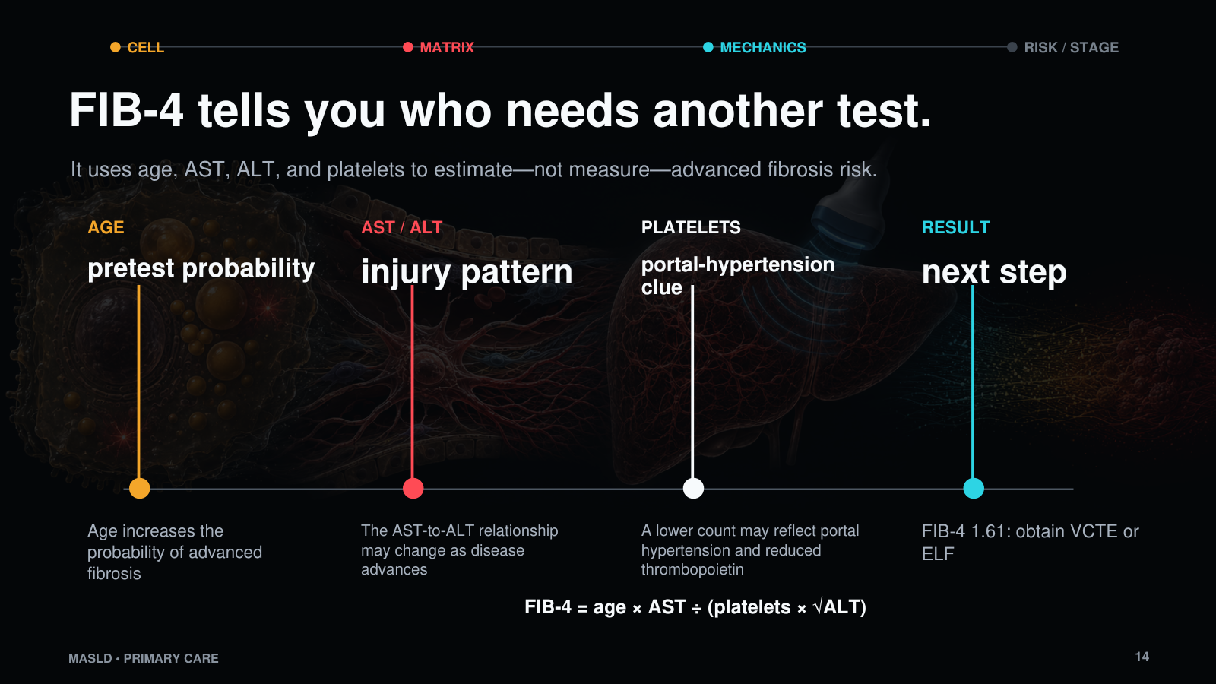
Notes:
FIB-4 is a triage tool. It is not a measurement of scar. It combines age, AST, ALT, and platelets to estimate the probability of advanced fibrosis. In primary care, its greatest value is the negative predictive value: a low result allows many patients to stay in primary care while we continue metabolic risk management. This patient's value is 1.61, so the question is not answered. That result does not diagnose F3 fibrosis. It tells us that we need a second test—usually VCTE or ELF—to look more directly at fibrosis risk.
Source: Rinella ME et al. AASLD Practice Guidance. Hepatology. 2023;77:1797-1835.

Slide 15
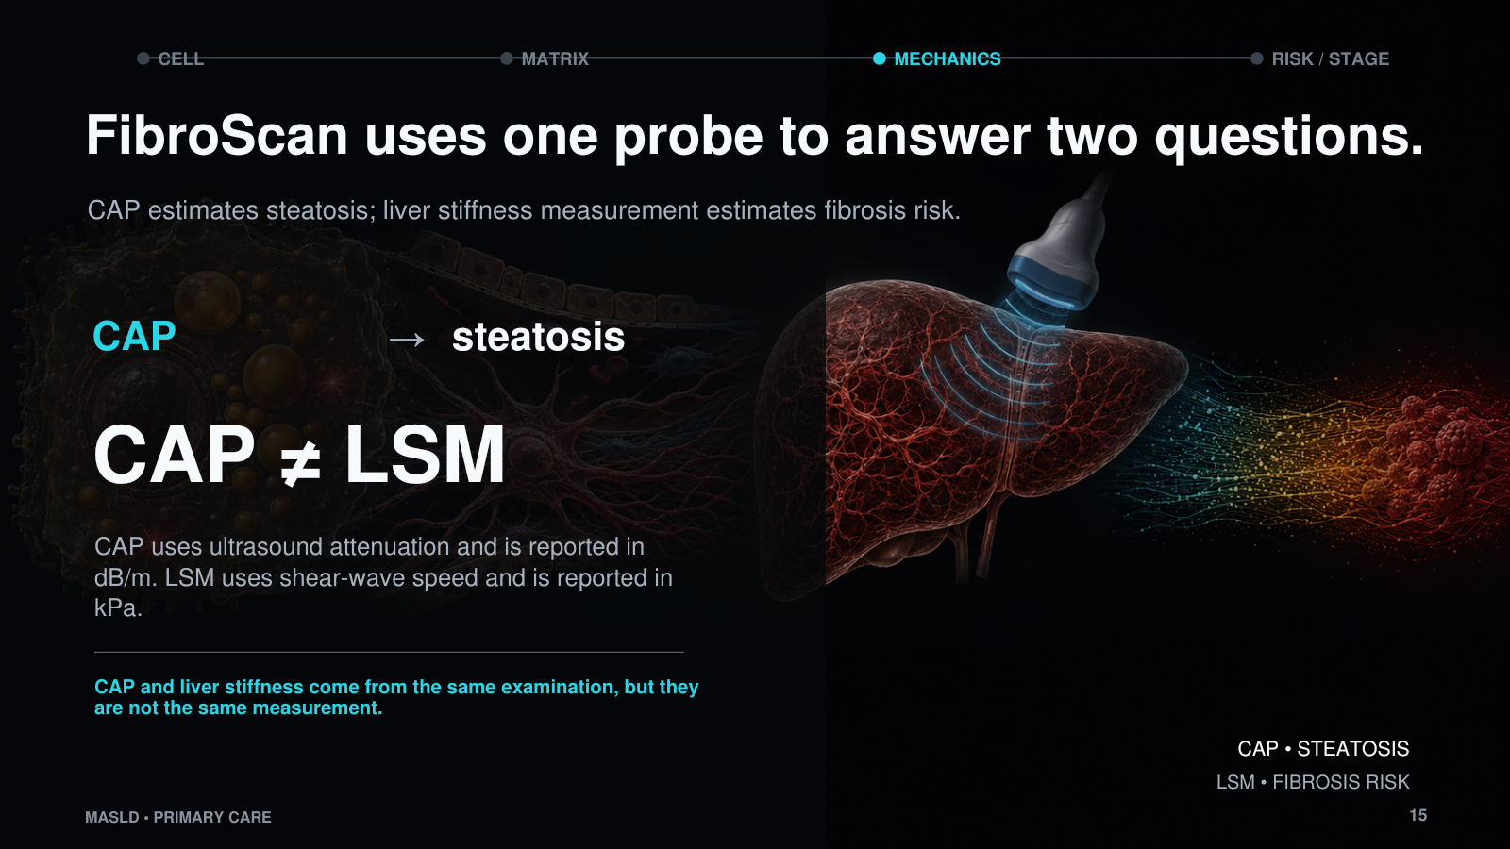
Notes:
FibroScan gives us two numbers from the same examination, but the numbers come from different physical measurements. CAP estimates steatosis by measuring how much the ultrasound signal is attenuated as it travels through the liver. Liver stiffness measurement follows the propagation of a mechanically generated shear wave and reports apparent stiffness in kilopascals. CAP is about fat. Liver stiffness is about the mechanical consequence that correlates with fibrosis risk. I would be very deliberate about separating those two concepts, because the same probe can make them feel like one measurement when they are not.

Slide 16
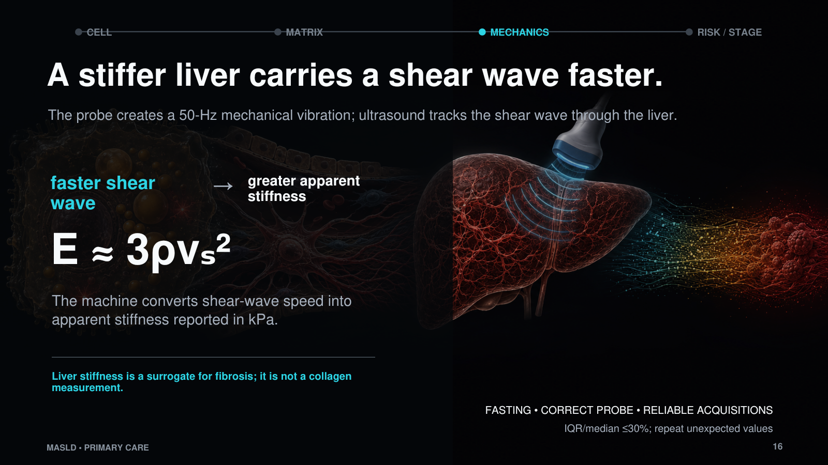
Notes:
The simplest clinical explanation is that a fibrotic liver loses flexibility. Technically, the probe creates a mechanical vibration at about 50 hertz, which launches a shear wave into the liver. Ultrasound then tracks how quickly that shear wave travels through the tissue. A faster shear wave corresponds to greater apparent stiffness, and the machine converts that speed into a value in kilopascals. It is not measuring how strongly a sound wave bounces back. CAP uses ultrasound attenuation for steatosis; the stiffness measurement uses shear-wave propagation. Food intake, inflammation, congestion, cholestasis, and poor acquisition can raise stiffness without adding collagen.
Source: Sandrin L et al. Ultrasound Med Biol. 2003;29:1705-1713.

Slide 17
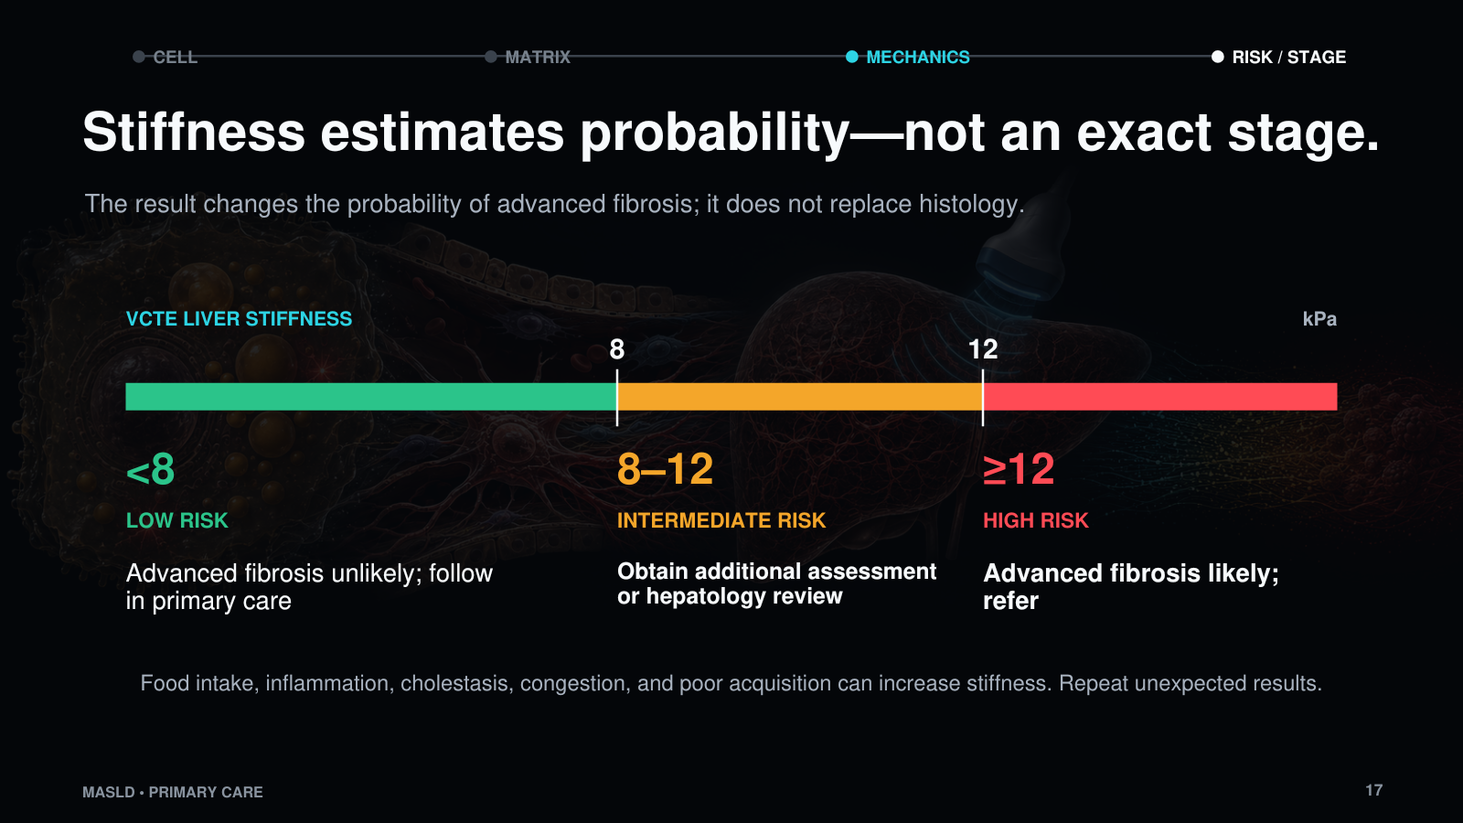
Notes:
A liver stiffness value changes probability; it does not produce a biopsy stage. In a primary-care pathway, less than 8 kPa generally places advanced fibrosis at low probability. Eight to 12 kPa is an intermediate range that needs additional assessment or hepatology review. Twelve kPa or higher raises substantial concern for advanced fibrosis. The exact interpretation still depends on the clinical context and the quality of the examination. If the result is unexpected, confirm fasting, probe selection, and acquisition quality and consider inflammation, cholestasis, or congestion before treating the number as collagen.
Source: Rinella ME et al. AASLD Practice Guidance. Hepatology. 2023;77:1797-1835.

Slide 18
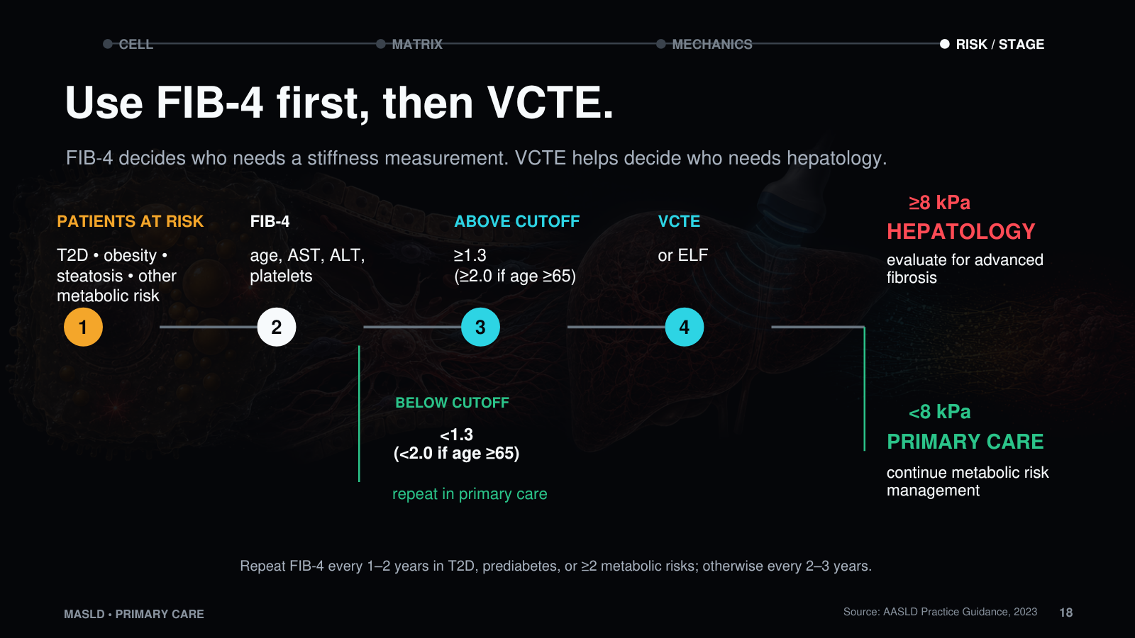
Notes:
For primary care, the sequence can remain simple. Start with the patients who have metabolic risk—especially type 2 diabetes, obesity, or steatosis on imaging—and calculate FIB-4. Below 1.3, most patients can remain in primary care with repeat assessment at the recommended interval. In adults 65 and older, use 2.0 as the lower threshold. Above the age-appropriate cutoff, obtain VCTE or ELF. A VCTE below 8 kPa generally supports primary-care follow-up. A value of 8 kPa or higher should lead to additional fibrosis assessment, and higher values make hepatology referral increasingly important. The point is not to label every patient; it is to avoid missing the patient whose management changes when fibrosis is found.
Source: Rinella ME et al. AASLD Practice Guidance. Hepatology. 2023;77:1797-1835.

Slide 19
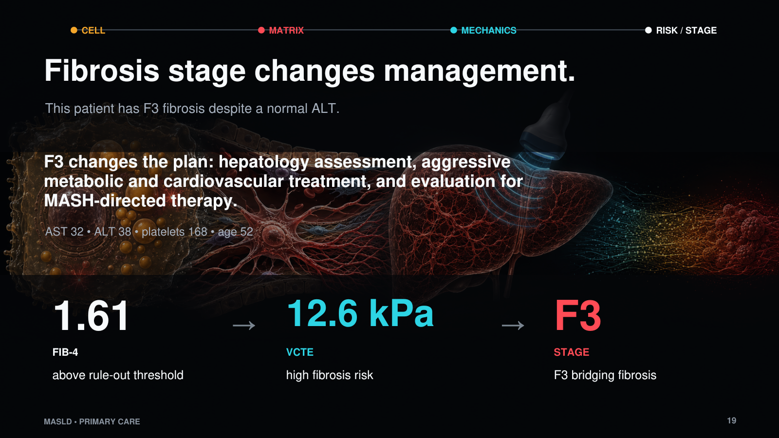
Notes:
This patient did not simply have fatty liver. He had F3 fibrosis, and that changes what happens next. He needs hepatology assessment, aggressive treatment of weight and cardiovascular risk, and evaluation for MASH-directed therapy. Lifestyle treatment remains foundational at every stage. Metformin should be used when appropriate for diabetes, but not presented as a fibrosis treatment. Coffee may be reasonable if the patient already drinks it and has no contraindication, but it is not the center of the plan. For noncirrhotic MASH with F2 to F3 fibrosis, current options may include resmetirom or semaglutide when the patient meets treatment criteria. If cirrhosis is present, management expands to HCC surveillance and portal-hypertension assessment. A nonselective beta blocker is used for clinically significant portal hypertension in compensated cirrhosis—not simply because a patient has F3 or F4 fibrosis.
Sources: FDA resmetirom approval, 2024. FDA semaglutide MASH approval, 2025. AASLD Practice Guidance on Risk Stratification and Management of Portal Hypertension and Varices in Cirrhosis, 2023.

